Slide 1
Autonomous Car
Eric Fong, Christian Alcalde, Abdullah Wardak
Notes:
30 minutes per group
20 minutes of speaking time
5 minutes for questions
5 minutes setup time
Each member should speak about the part they are responsible for
Comprehensive for all material presented in class.
Project description
block diagram
Description of component functions
schematic
board
Algorithm definitions and/or flow charts

Slide 2
Project Abstract
This project aims to design a computer-controlled car that can navigate a manually designated path. The car will monitor environmental feedback using Infrared reflective sensors, ultrasonic proximity sensors, and an Inertial Measurement Unit. Data collected by these devices will be used to control the motors for following the manually specified path, circumnavigating obstacles on said path, and collecting data on how the car navigated its way along or away from the path.
CA

Slide 3
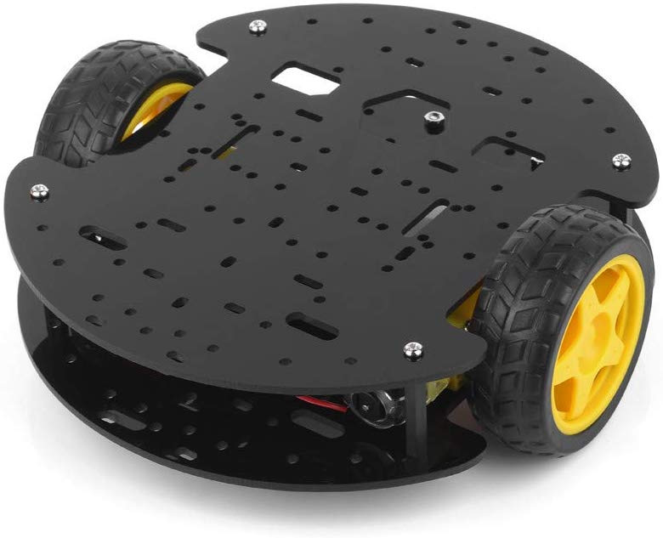
Base Objectives
Car (Path following blue painter tape)
Obstacle detection
Obstacle circumnavigation or go around it
Travel statistic logging and display
AW

Slide 4
Stretch Goals
Advanced obstacle reaction
get accurate obstacle readings while car is in motion
detect if obstacle is moving or stationary
back up from approaching obstacle
wait out through traffic
add another motion sensor, detect moving obstacles via triangulation/sensor differences, avoidance swerving
Log exporting via serial UART cable
exporting functions triggered with a button press when plugged in
draw a map using x-y position data from a run and export the picture
AW

Slide 5
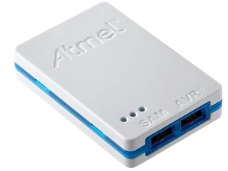
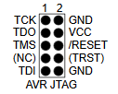

Software
Atmel Studio 7
IDE to program the AT32UC3C2512C-A2UT-ND
Allows us to program and debug code for the car
Will be using the Atmel-ICE Basic JTAG Programmer
Using a micro B cable to connect the programmer and computer
Connects to our board through a 2x5 male pin header
Will not be using (NC), (TRST), or /RESET pins
CA

Slide 6
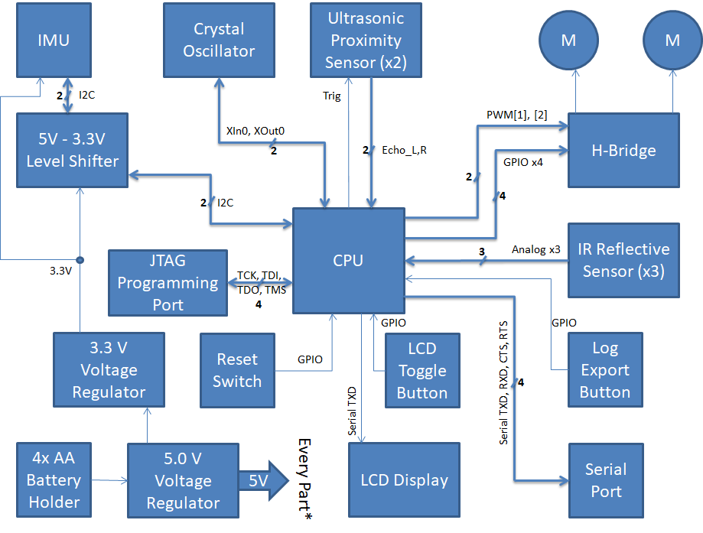
Block Diagram
EF
Notes:
IMU is the only 3.3 V device
connection directions
unique/proprietary comms protocols

Slide 7
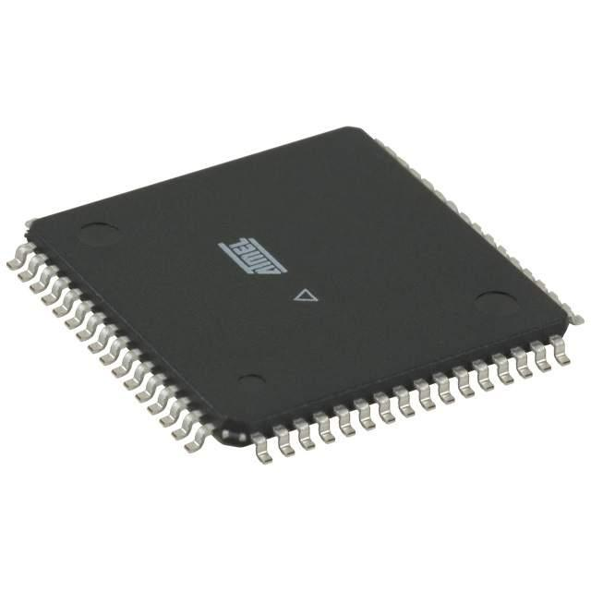
CPU
AT32UC3C2512C-A2UT-ND
32-bit AVR microcontroller
Operating Voltage of 3.3 V to 5 V
Provided a regulated voltage of 5V
64 pins, 45 pins which can be used as GPIO
Built-in floating point processing unit
Useful for IMU calculations
IMU communicates with CPU over I²C
Four PWM channels
Implementing analog voltage control using digital signaling
I²C (is TWIM) compatibility
Serial Connections on UART/USART
Programmable through JTAG
Joint Test Action Group
AW

Slide 8
Subsystems - Line Follower
components: CPU ( + internal Analog to Digital Converter), IR reflective sensors (x3)
Follows a blue painter tape path

Slide 9
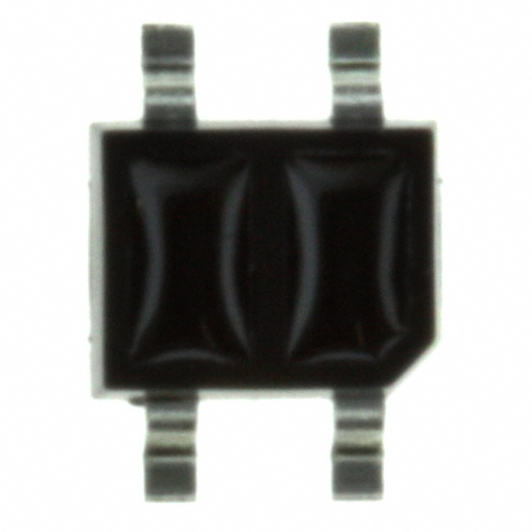
IR Sensor
3 IR sensors (Part #: QRE1113GR) will allow the car to read the blue line and follow it
Sensors will be placed side by side
Facilitates tape-path follower subsystem
Two sensors will read white surface and one will read the blue line
Right and left turns will be done by two of the sensors on the sides
AW

Slide 10
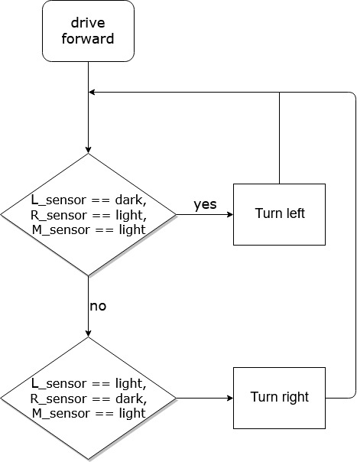
Line Tape Follower
Path following with blue painter tape using one single tape to make the track
Detecting right or left turn in track:
while(!endOfTravel) { if (L_sensor == dark) turnLeft(); else if (R_sensor == dark) turnRight(); else driveForward(); }
AW

Slide 11
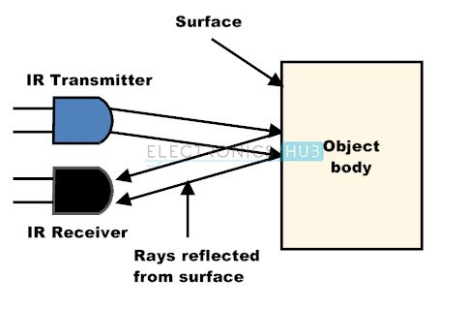
Left and Right IR Sensor
AW

Slide 12
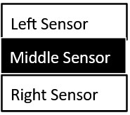
Detecting Left vs Right
Middle sensor should always detect line
Going straight, the right sensor eventually detects the line
Car knows to move right to realign middle sensor with line
Same case for the left sensor
Stops when all sensor turns dark for 2s in an intersection
AW

Slide 13
Reaching to an Intersection
All three sensors turn dark for < 2 seconds still moves forward
Stops if all three sensor were dark > 2 sec
End

Slide 14
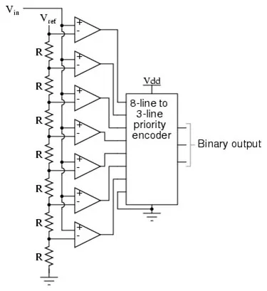
Analog to Digital Conversion
IR sensor outputs analog signals
CPU converts Analog signal to Digital
Each sensor requires its own ADC

Slide 15
Subsystems - Power
components: 5V regulator, 3.3V regulator, battery pack
Powers the board and the components
Slide switch is used to turn the board on or off
CA

Slide 16
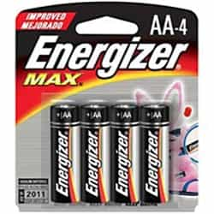
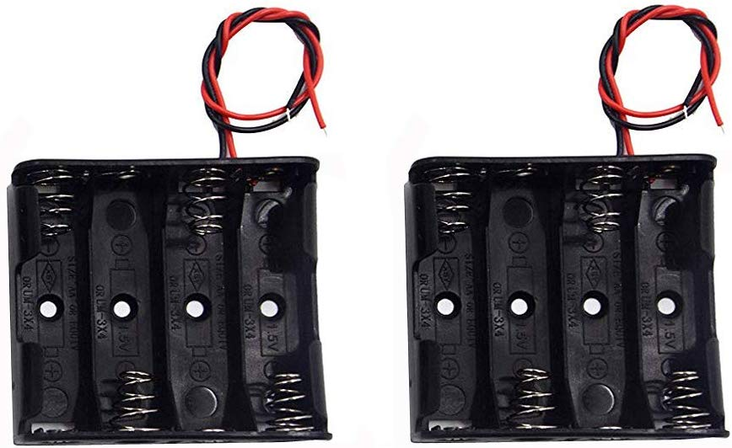
Battery Pack
Most of our peripherals run at 5V
4 AA battery holder
Each AA battery = 1.5V
With four batteries = 6V
However, our board cannot run on 6V

Slide 17
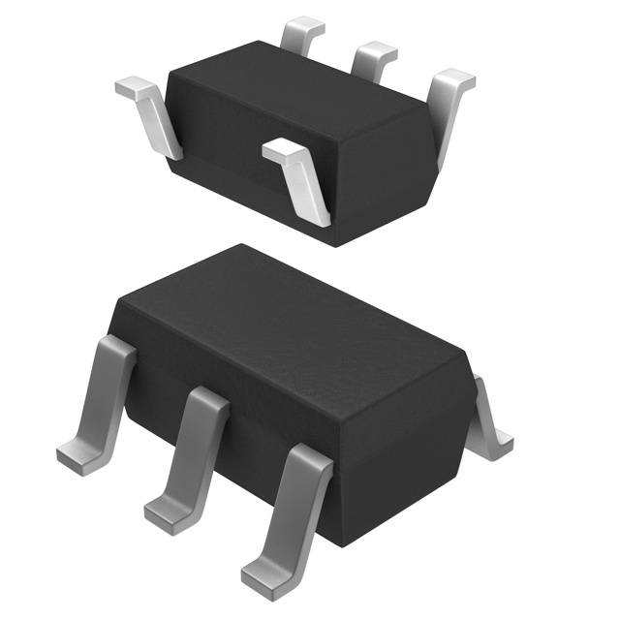
Voltage Regulators
We need two, 3.3V and 5V
AP2210K-3.3TRG1 and AP2210K-5.0TRG1
3.3V Regulator
Powers the SparkFun Inertial Measurement Unit (Accelerometer)
5V Regulator
Converts 6V from battery pack
Powers the CPU and the rest of our components
Feeds into the 3.3V Regulator
Notes:
What it actually does?
Provides a constant voltage depending on the regulator you use
5V feeds into 3.3V
Even though there’s a voltage drop between the two, its still within the allowable range
Using linear voltage regulator quirks
Fine for our application

Slide 18
Subsystems - Obstacle Detection
components: CPU, ultrasonic sensors (x2)
Utilizes two ultrasonic sensors to get past different obstacles
Activates Circumnavigation Algorithm
Constraints:
Assume obstacles are no larger than 60 cm x 60 cm
Algorithm ends if car travels more than 250 cm

Slide 19
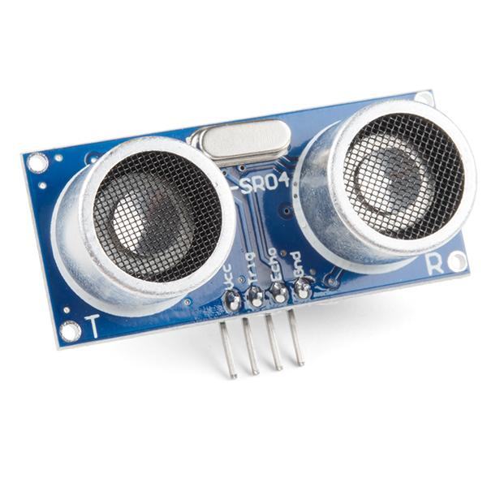
Ultrasonic Sensor
SEN-15569 (HC-SR04)
Using two Ultrasonic Sensor 40kHz
Placed side by side @ 15 degree offset at the front of our chassis
Custom communication protocol using TRIG and ECHO
Sends out eight 40kHz signals and detects a pulse signal back
Used for our car’s obstacle detection
If CPU receives signal indicating obstruction less than 100 mm
Car will activate circumnavigation system
Distance Formula:
Distance = (Time *(340 m/s) )/2

Slide 20
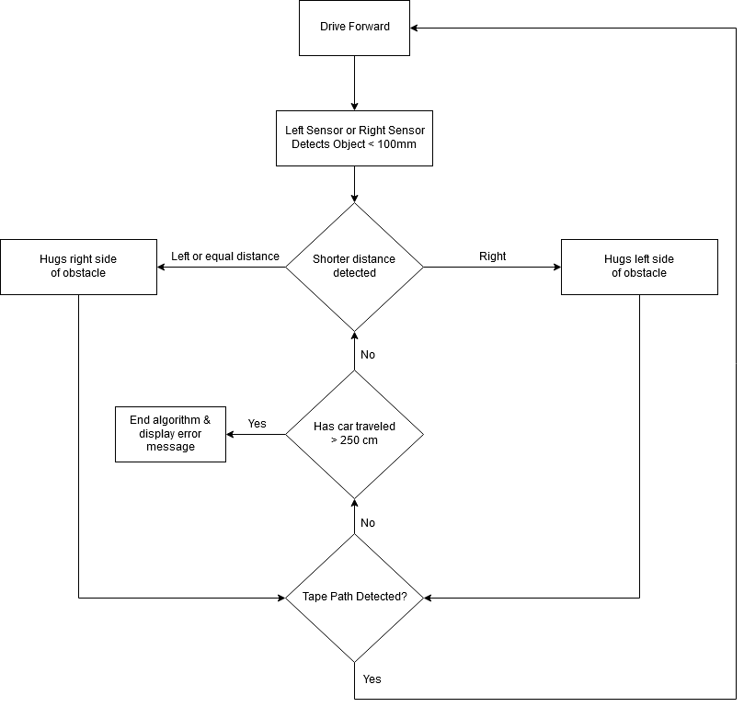
Circumnavigation Algorithm
Compare distances between two sensors
Car moves in direction of shorter distance
Car will “hug” an obstacle until it detects the tape path again or exceeds 250 cm
Sensors detect distance of ~215 mm away and always maintains that distance
When a sensor detects a drop in distance, the motor furthest from the object turns the car to maintain that distance

Slide 21
Motor Control
Block Diagram
EF

Slide 22
Subsystem - Motor Control
Components: CPU, H-bridge, motors (x2)
Controls the direction that the car can move
Forward
Backward
Turning
Controls speed of vehicle
Vs to motors is a constant 5V
CPU & L293DD can effectively lower the voltage to the motors using PWM inputs to H-bridge enables

Slide 23
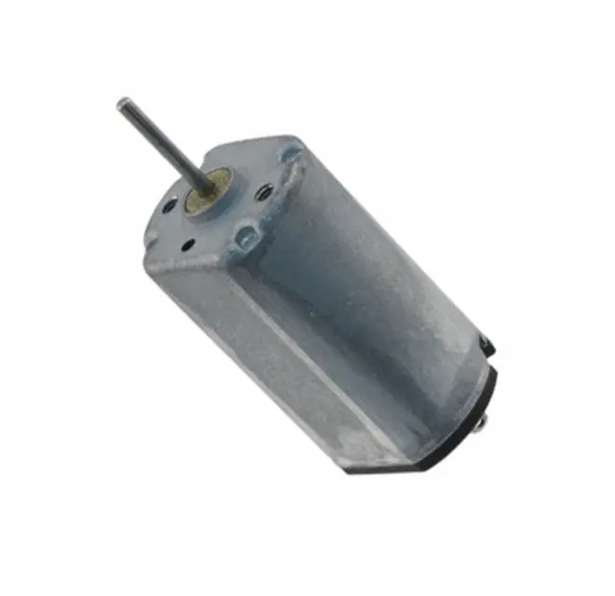
DC Brushed Motors
two terminals - one Vs, one ground
runs on DC
direction of motion determined by which terminal is connected to Vs
In general the speed of the motor is proportional to the input voltage

Slide 24
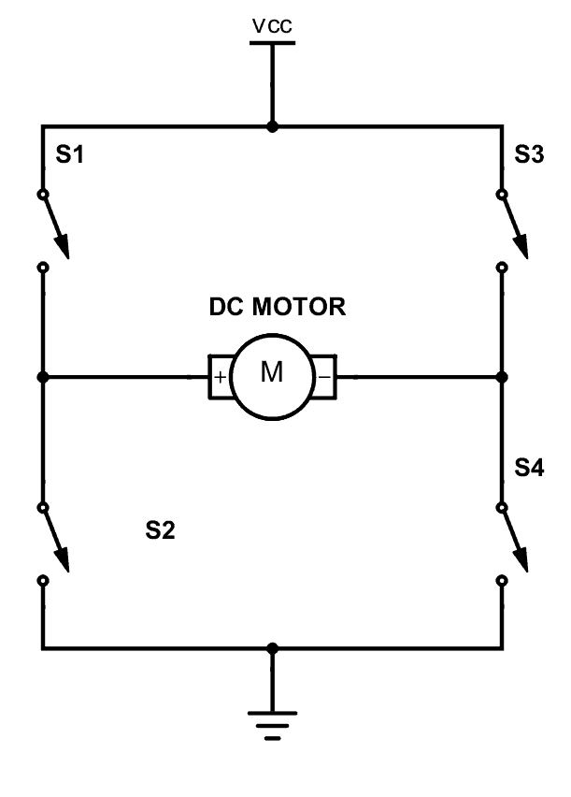
H-Bridge Circuit
need to be able to control which motor terminal receives Vs and which is grounded to control direction
we can achieve this using four switches, in our case transistors

Slide 25
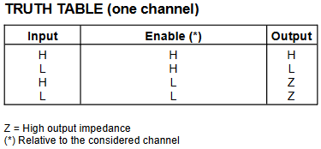
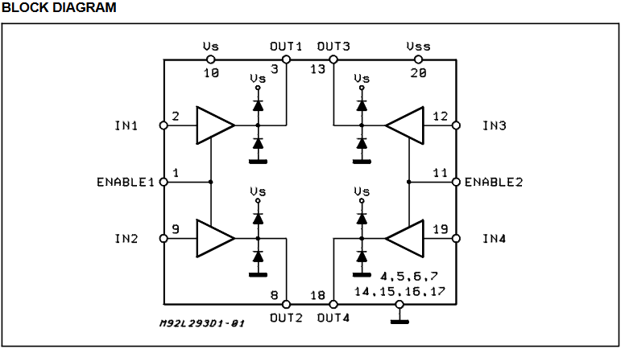
How to Use the L293DD H-Bridge
Vs takes supply Voltage, Vss takes logic supply Voltage
L293DD contains two H-Bridges
bringing Enable1 high allows Out1 & 2 to send or receive current
logical ‘high’ on In feeds Vs through its corresponding Out, logical ‘low’ connects Out to ground

Slide 26
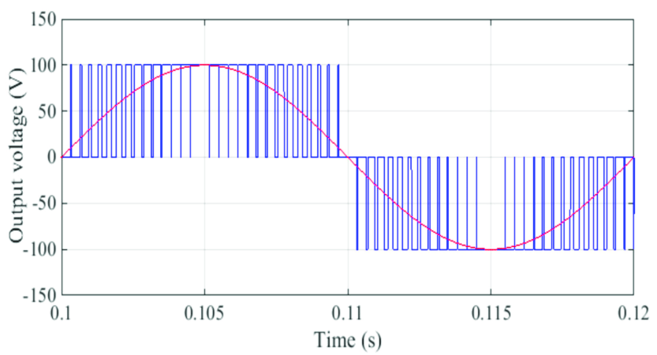
Controlling Motor Speed with the L293DD
The L293DD has inputs: Enable1, Enable2
If we toggle the enable signals with a frequency in the KHz range, we get an ‘average’ voltage that’s less than Vs
The protocol that handles this rapid toggling is PWM
Controlled, variable motor speed is achieved using Pulse Width Modulation (PWM)
The ‘average on-time’ is referred to as a ‘duty cycle,’ i.e. a duty cycle of 70% with a 5 V Vs should result in an ‘average’ Voltage of 3.5 V
Notes:
alt. method of controlling speed would be to use an adjustable or switching V reg, but would require more hardware and can already replicate this with the L293DD

Slide 27
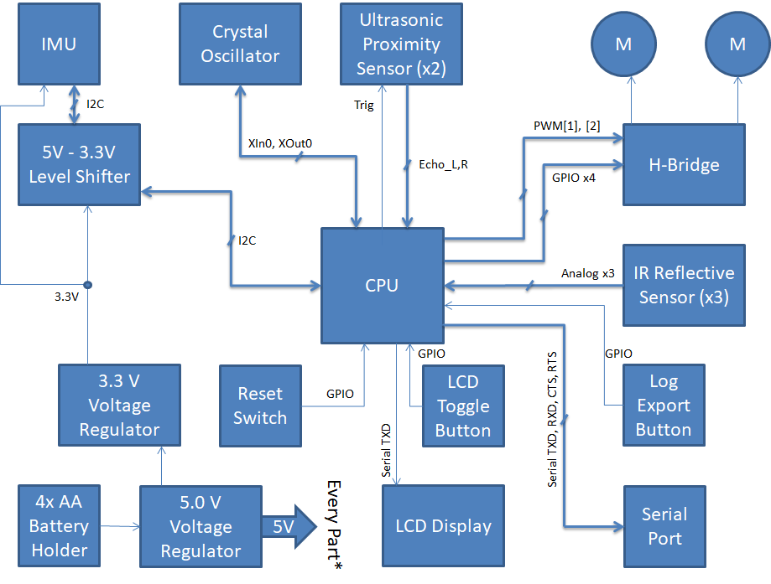
Positional Feedback - Block Diagram

Slide 28
Subsystem - Positional Feedback
components: CPU, Inertial Measurement Unit module, bidirectional level shifter, crystal oscillator
Logs acceleration data
IMU will be used in conjunction with crystal oscillator for accurate timekeeping and consistent, precise measurements
Velocity and position data obtained by integrating acceleration data

Slide 29
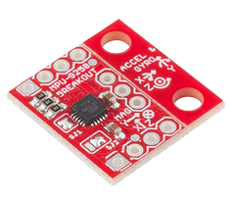
IMU Module
SparkFun Electronics SEN-13762
Module that includes an accelerometer, gyroscope, magnetometer
Powered by the MPU-9250
We only require the accelerometer component
Has three 16-bit ADCs for digitizing accelerometer outputs
Data is communicated over the I²C protocol
Operates on 3.3 V logic
Level shifter needed to communicate with the 5V CPU
Can use this one module to obtain data on acceleration, velocity and position using integration
Acceleration data comes in as a list of measurements, so to integrate this we need to use Riemann Sums

Slide 30
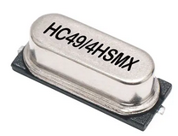
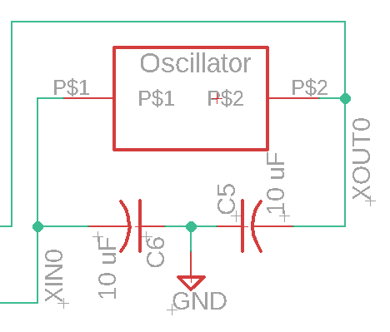
Crystal Oscillator Circuit
Necessary for accurate calculation of velocity and position data in our CPU
Riemann sums use a constant Δt across all summations
12 MHz crystal
Two 10pF capacitors connected to the crystal in parallel
Piezoelectric response from crystal interacts with the capacitors to cause a consistent resonance to use for timekeeping
capacitors damp unwanted frequencies
capacitance in parallel elements = (C₁⁻¹ + C₂⁻¹)⁻¹ so our two 10 uF capacitors combine to an effective 5 uF capacitor, matching our crystal’s requirements

Slide 31
Positional Feedback Display -
Block Diagram

Slide 32
Subsystem - Positional Feedback Display
components: CPU, LCD display module, button
Displays data from the IMU and any additional statistics derived from it

Slide 33
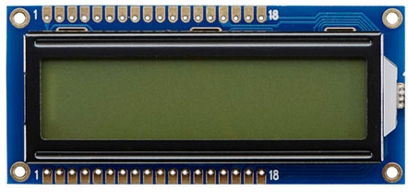
LCD Character Display
16x2 LCD character display
Receives data from CPU over a serial connection
Info to show on the display
Total distance traveled from start, average speed, average acceleration, etc.
Will need to calculate some of these values from the acceleration-velocity-position data
The corresponding push button will be used to cycle through which statistic is displayed
Notes:
output only device → serial connection only contains TXD from CPU

Slide 34
Subsystem - Log Export
components: CPU, 4-pin header, button
Stretch goal
Exports a log of the car’s travel data to an external computer over a serial UART connection
Exporting process is triggered on the corresponding push button signal

Slide 35
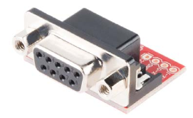
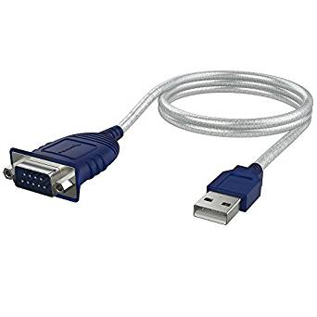
RS232 Shifter
Allows our board to communicate with a computer
4-pin header on the board connects to this module
Adapts a 9-pin Serial connection to a USB 2.0 port
Export travel logs stored on the CPU are transferred to a computer

Slide 36
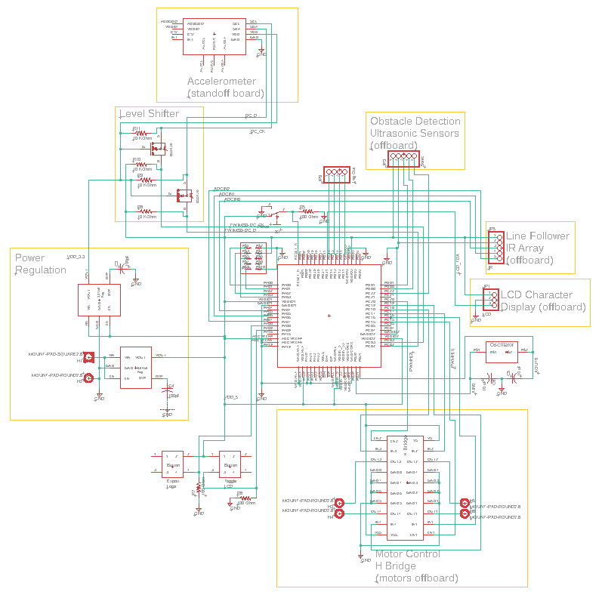
Schematic

Slide 37
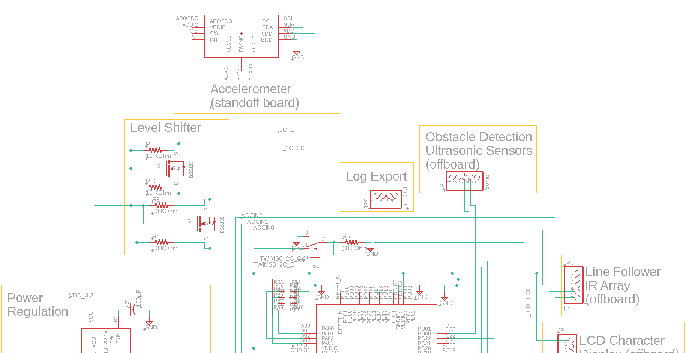

Slide 38
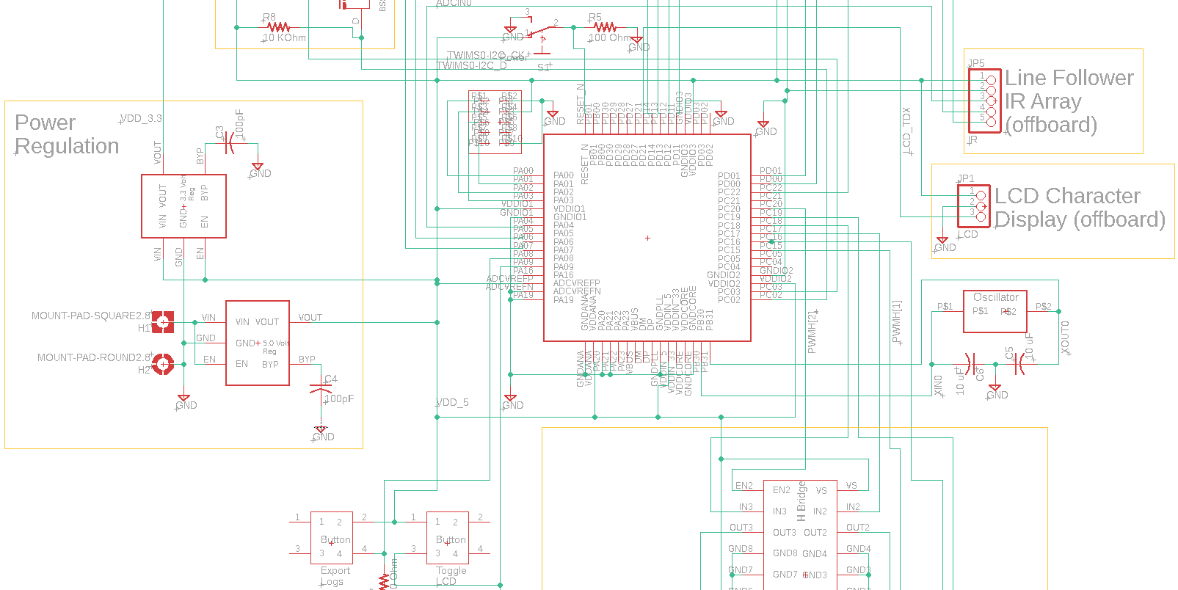

Slide 39
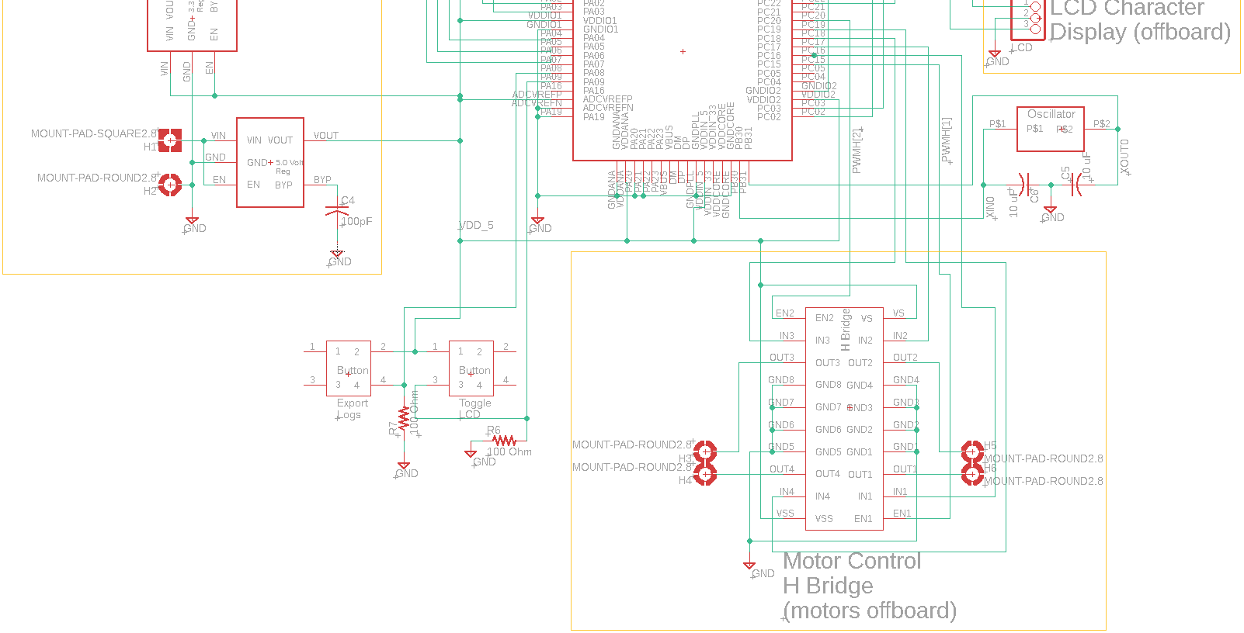

Slide 40
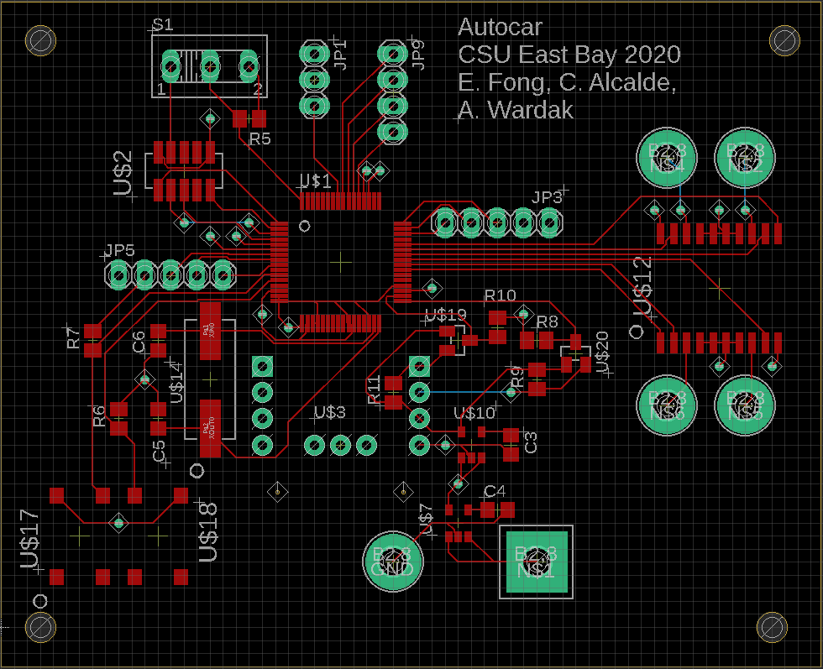
Main Board Layout

Slide 41
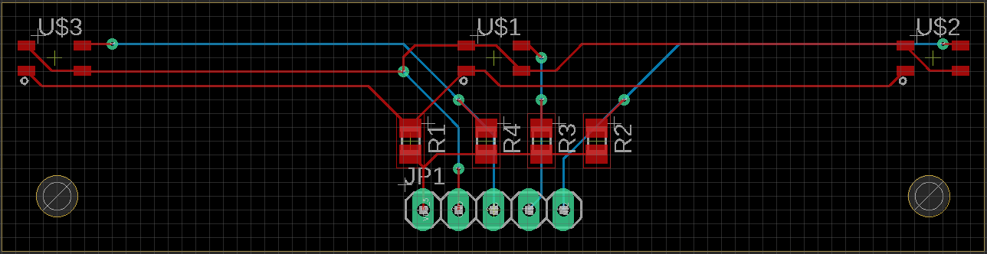
IR Sensor Array - Board Layout

Slide 42
Thank You!

